Slide 1

Bucket Sort and Radix Sort
Topic 1.3.2
By: Er.Bhavneet Kaur
Master Subject Co-ordinator
CSE 2nd Year

Slide 2
Time complexity of Sorting
Several sorting algorithms have been discussed and the best ones, so far:
  Merge sort: O( n log n )
  Quick sort (best one in practice): O( n log n ) on average, O( n² ) worst case
Can we do better than O( n log n )?
  No.
  It can be proven that any comparison-based sorting algorithm will need to carry out at least O( n log n ) operations

Slide 3
Restrictions on the problem
Suppose the values in the list to be sorted can repeat but the values have a limit (e.g., values are digits from 0 to 9)
Sorting, in this case, appears easier
Is it possible to come up with an algorithm better than O( n log n )?
  Yes
  Strategy will not involve comparisons

Slide 4
Bucket sort
Idea: suppose the values are in the range 0..m-1; start with m empty buckets numbered 0 to m-1, scan the list and place element s[i] in bucket s[i], and then output the buckets in order
Will need an array of buckets, and the values in the list to be sorted will be the indexes to the buckets
  No comparisons will be necessary
  Bucket sort assumes that the input is generated by a random process that distributes elements uniformly and independently over the interval [0,1].

Slide 5
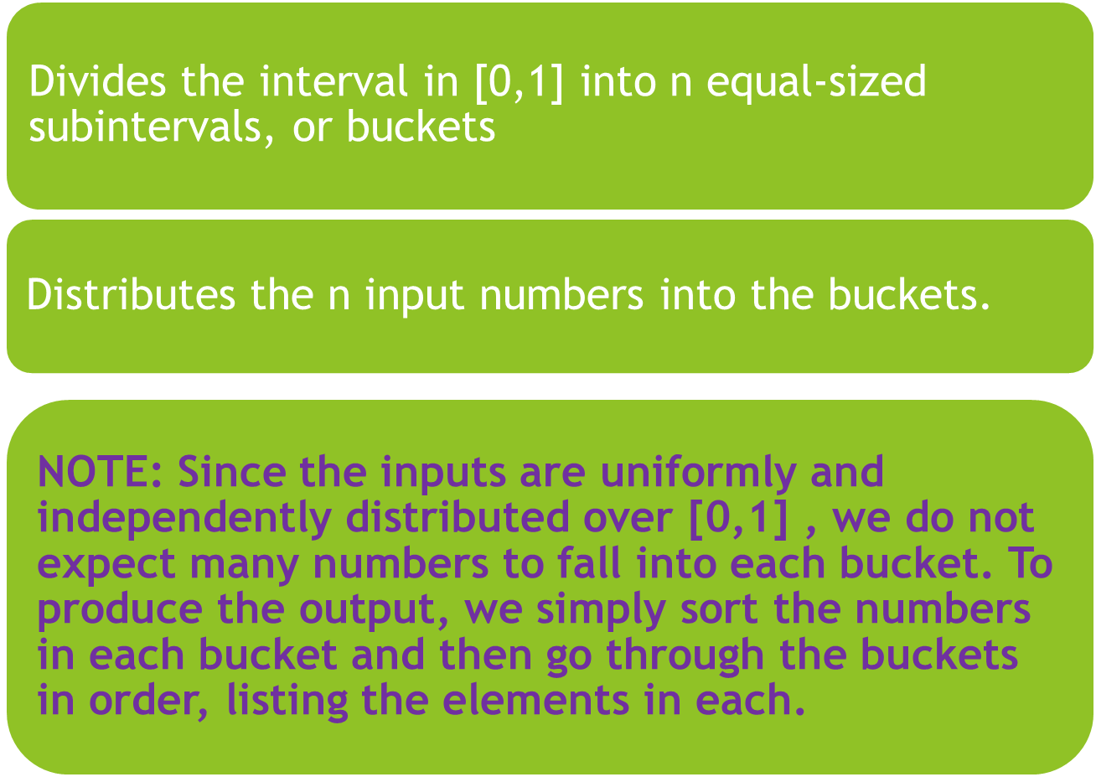

Slide 6
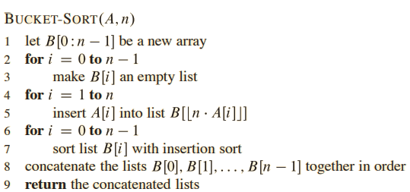
Bucket sort algorithm

Slide 7
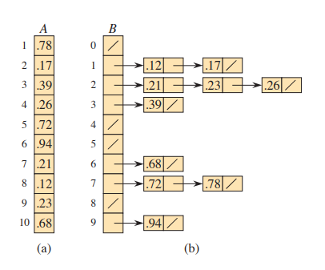
EXAMPLE
The operation of BUCKET-SORT for n =10. (a) The input array A[1 :10]. (b) The array B[0 :9] of sorted lists (buckets) after line 7 of the algorithm, with slashes indicating the end of each bucket. Bucket i holds values in the half-open interval [i/10,( i+ 1)/10]. The sorted output consists of a concatenation of the lists B[0]; B[1]; …. ; B[9] in order.

Slide 8
Values versus entries
If we were sorting values, each bucket is just a counter that we increment whenever a value matching the bucket’s number is encountered
If we were sorting entries according to keys, then each bucket is a queue
  Entries are enqueued into a matching bucket
  Entries will be dequeued back into the array after the scan

Slide 9
Time complexity
Bucket initialization: O( m )
From array to buckets: O( n )
From buckets to array: O( n )
  Even though this stage is a nested loop, notice that all we do is dequeue from each bucket until they are all empty –> n dequeue operations in all
Since m will likely be small compared to n, Bucket sort is O( n )
  Strictly speaking, time complexity is O ( n + m )

Slide 10
Sorting integers
Can we perform bucket sort on any array of (non-negative) integers?
  Yes, but note that the number of buckets will depend on the maximum integer value
If you are sorting 1000 integers and the maximum value is 999999, you will need 1 million buckets!
  Time complexity is not really O( n ) because m is much > than n. Actual time complexity is O( m )
Can we do better?

Slide 11
Radix sort
Idea: repeatedly sort by digit—perform multiple bucket sorts on S starting with the rightmost digit
If maximum value is 999999, only ten buckets (not 1 million) will be necessary
Use this strategy when the keys are integers, and there is a reasonable limit on their values
  Number of passes (bucket sort stages) will depend on the number of digits in the maximum value

Slide 12
Example: first pass
12 | 58 | 37 | 64 | 52 | 36 | 99 | 63 | 18 | 9 | 20 | 88 | 47
20
12 52
63
64
36
37 47
58
1888
9
99
20 | 12 | 52 | 63 | 64 | 36 | 37 | 47 | 58 | 18 | 88 | 9 | 99

Slide 13
Example: second pass
20 | 12 | 52 | 63 | 64 | 36 | 37 | 47 | 58 | 18 | 88 | 9 | 99
9
12
18
20
3637
47
52 58
63
64
88
99
9 | 12 | 18 | 20 | 36 | 37 | 47 | 52 | 58 | 63 | 64 | 88 | 99

Slide 14
Example: 1st and 2nd passes
12 | 58 | 37 | 64 | 52 | 36 | 99 | 63 | 18 | 9 | 20 | 88 | 47
sort by rightmost digit
20 | 12 | 52 | 63 | 64 | 36 | 37 | 47 | 58 | 18 | 88 | 9 | 99
sort by leftmost digit
9 | 12 | 18 | 20 | 36 | 37 | 47 | 52 | 58 | 63 | 64 | 88 | 99

Slide 15
Radix sort and stability
Radix sort works as long as the bucket sort stages are stable sorts
Stable sort: in case of ties, relative order of elements are preserved in the resulting array
  Suppose there are two elements whose first digit is the same; for example, 52 & 58
  If 52 occurs before 58 in the array prior to the sorting stage, 52 should occur before 58 in the resulting array
This way, the work carried out in the previous bucket sort stages is preserved

Slide 16
Time complexity
If there is a fixed number p of bucket sort stages (six stages in the case where the maximum value is 999999), then radix sort is O( n )
  There are p bucket sort stages, each taking O( n ) time
Strictly speaking, time complexity is
O( pn ), where p is the number of digits (note that p = log₁₀m, where m is the maximum value in the list)

Slide 17
About Radix sort
Note that only 10 buckets are needed regardless of number of stages since the buckets are reused at each stage
Radix sort can apply to words
  Set a limit to the number of letters in a word
  Use 27 buckets (or more, depending on the letters/characters allowed), one for each letter plus a “blank” character
  The word-length limit is exactly the number of bucket sort stages needed

Slide 18
Summary
Bucket sort and Radix sort are O( n ) algorithms only because we have imposed restrictions on the input list to be sorted
Sorting, in general, can be done in
O( n log n ) time

